Slide 1
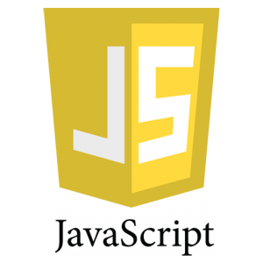
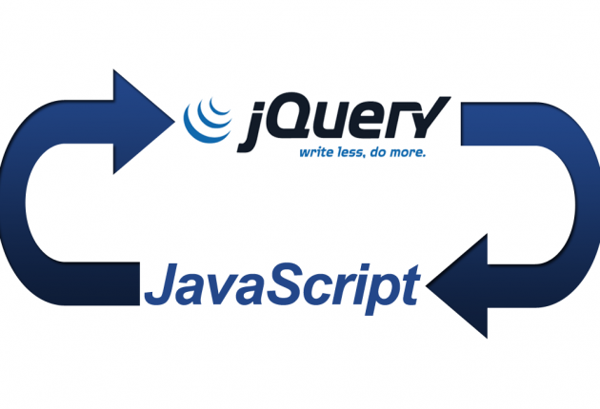
Jquery
A lightweight, “write less, do more” Javascript Library

Slide 2
What is jQuery?
A library of pre-written JavaScript which allows for easier development of JavaScript-based applications
The purpose of jQuery is to make it much easier to use JavaScript on your website.
jQuery takes a lot of common tasks that require many lines of JavaScript code to accomplish, and wraps them into methods that you can call with a single line of code.
In addition, jQuery has plugins for almost any task out there.

Slide 3
jQuery Advantages
Popularity: The most popular Javascript library in use on the internet, with many major sites using it.
Cost: Free and open source – Available to everyone
Appearance: Fairly streamlined.
Complexity: Very easy to use compared to other Javascript libraries and uses simple syntax and condensed methods
Support: Strong community with great documentation and many libraries, despite being somewhat new.

Slide 4
jQuery Syntax
The jQuery syntax is tailor made for selecting HTML elements and performing some action on the element(s).
Basic syntax is: $(selector).action()
A $ sign to define/access jQuery
A (selector) to "query (or find)" HTML elements
A jQuery action() to be performed on the element(s)

